Slide 1


P581 High Cloud Airlines
Group - 1
Rithik Aggarwal
Vaishnavi Ojha
Bikash Gupta Bikash
M.Usha Rani
Nikita Kiran More

Slide 2

OBJECTIVES
Purpose:
To perform a comprehensive analysis of High Cloud Airlines' operations, focusing on optimizing performance and enhancing customer satisfaction.
Key Goals:
Identify Trends: Analyze flight data to uncover patterns in passenger traffic, peak travel times, and popular routes.
Operational Efficiency: Evaluate load factors, busiest routes, top preferred airlines by the passengers.
Data-Driven Decision Making: Utilize insights from the analysis to support strategic decision-making for future growth and sustainability.
Expected Outcome:
Provide actionable insights and recommendations that drive efficiency, profitability, and customer satisfaction for High Cloud Airlines.

Slide 3
METHODS USED
Data Collection and Cleaning:
Imported the data from different sheets and performed data cleaning (renaming columns and changing their datatypes)
Data Connection & Modelling:
Created data modelling in Excel, Power BI and Tableau and performed joins in MySQL to create a relationship between the different tables.
Exploratory Data Analysis (EDA):
Descriptive Statistics: Calculated key metrics like Load Factor by SUM(TotalPasengers)/SUM(Available Seats). Segmenting some columns like ‘WeekdayType’ into weekdays & weekends.
Data Visualization: Utilized charts (bar, line, KPI Cards, etc.) and heatmaps to visualize trends, correlations, and anomalies. Used Date and Location Filters as well to study the data by origin and destination flights.
Reporting & Dashboarding:
Developed dynamic dashboards using Power BI/Tableau for real-time insights.
Cross Verify through SQL Queries:
Verified all the values by firing SQL queries to validate the reliability of the reports and the dashboards.

Slide 4

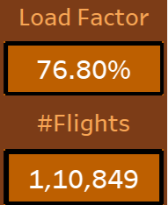
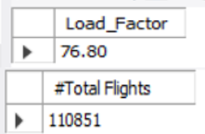

Cross-verification of all the key metrics >
Cross-verification of all the key metrics
KPIs – Overall Load Factor and #Flights

Slide 5
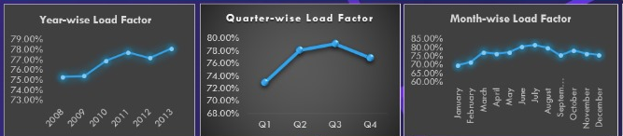
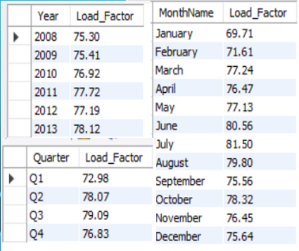
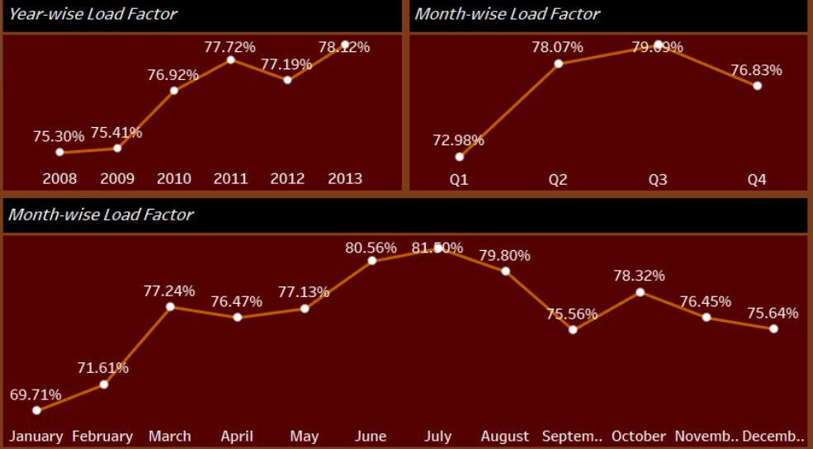
Year, Quarter, Month wise Load Factor

Slide 6
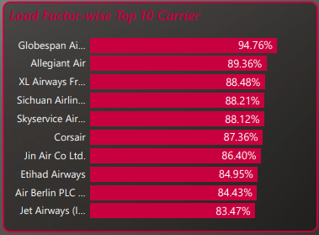
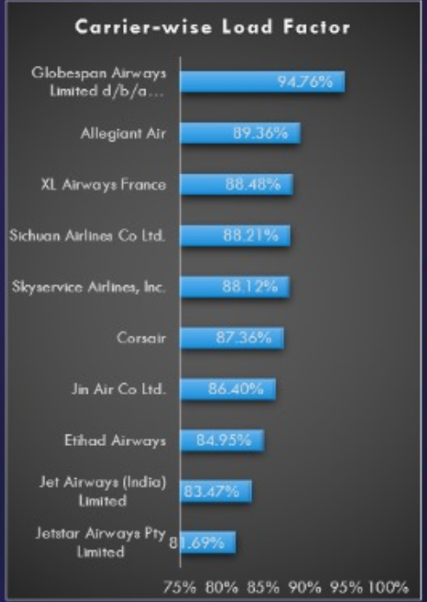
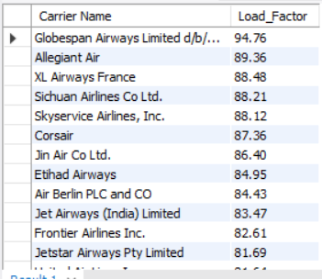
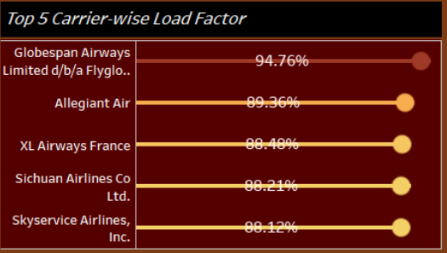
TOP Carrier-wise Load Factor

Slide 7
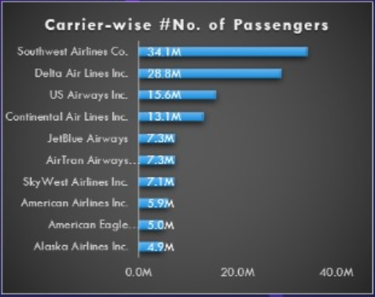
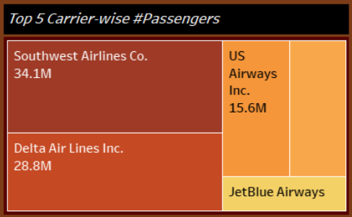
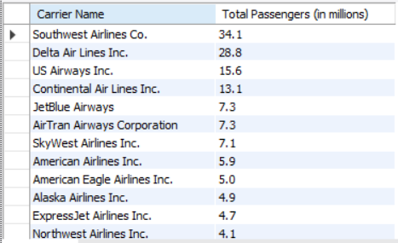
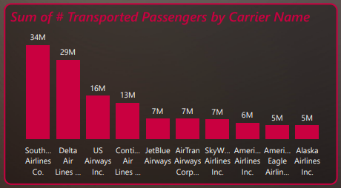
TOP Carrier-wise #Passengers

Slide 8
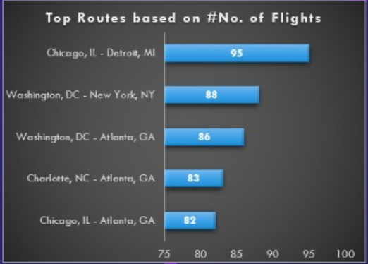
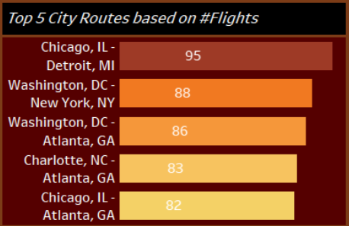
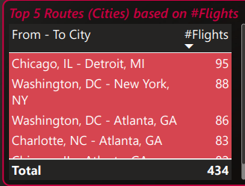
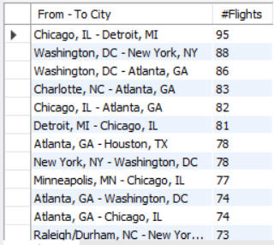
TOP Routes wise #Flights

Slide 9
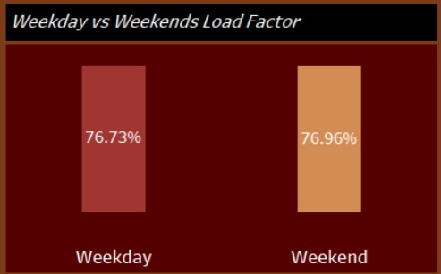


TOP Routes wise #Flights

Slide 10
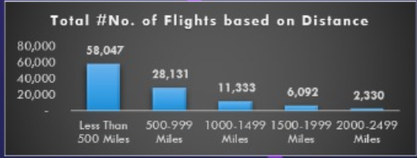
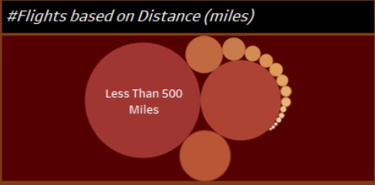
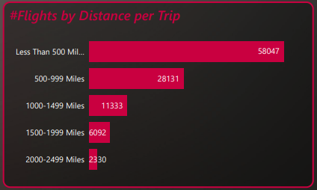
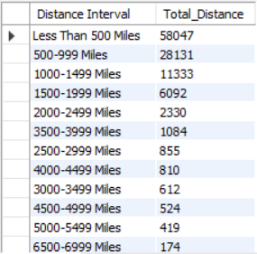
Flights Based On Distance

Slide 11
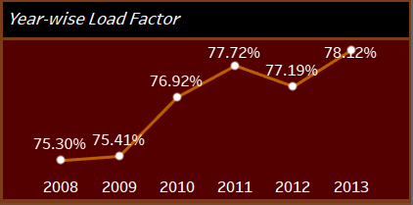
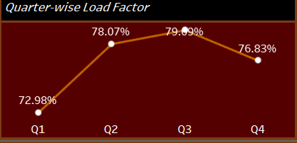
Overall Analysis
1. YoY Load Factor is in increasing trend:
Indicating a good sign overall for the airline industry.
2. Quarter-wise Load Factor:
Q1 has low load factors, Q2 and Q3 have comparatively high load factors, while Q4 has average. Same trend is seen overall as well as each year’s data. So an in-depth analysis could be done to find out the root cause for this trend. Apparently, it is because of the holidays in USA in Q2 and Q3 that the people tend to travel more frequently. And most of the data is from USA only.
3. Similar trends on Weekends & Weekdays on the basis of Load Factors

Slide 12
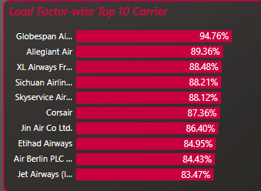
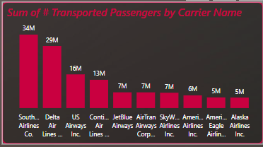
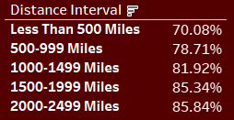
Overall Analysis
4. Top 10 Carrier Names by Number of passengers and Top 10 Carrier Names by Load Factor:
There is no overlapping of even a single carrier name between the two indicating that if total number of passengers overall in total of a airline carrier is high, it does not necessarily mean that the load factor of the aircraft should also be high or vice-versa.
5. Flights Distance and Load Factors are inversely proportional:
As distance of a single flight increases, the load factor decreases in the trend shown. In less than 500 miles flights, load factor trends b/w 68-72% while it increases in every distance slabs and ultimately has a value of 86-87% in the 2000-2499 miles category.

Slide 13
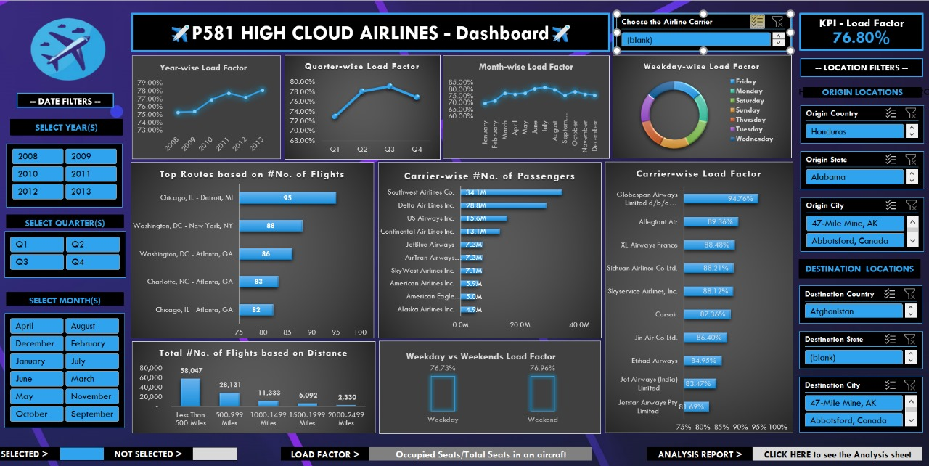
All Dashboards for Reference
Excel Dashboard

Slide 14
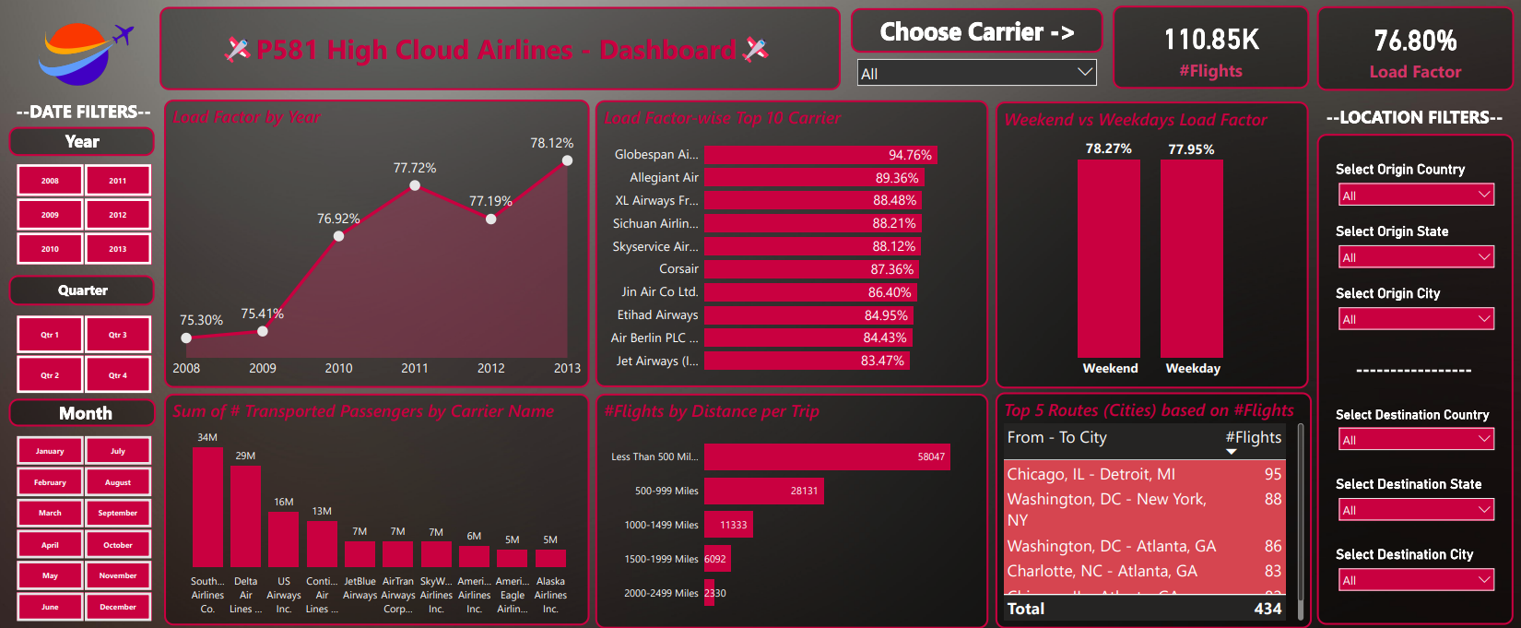
Power BI Dashboard

Slide 15
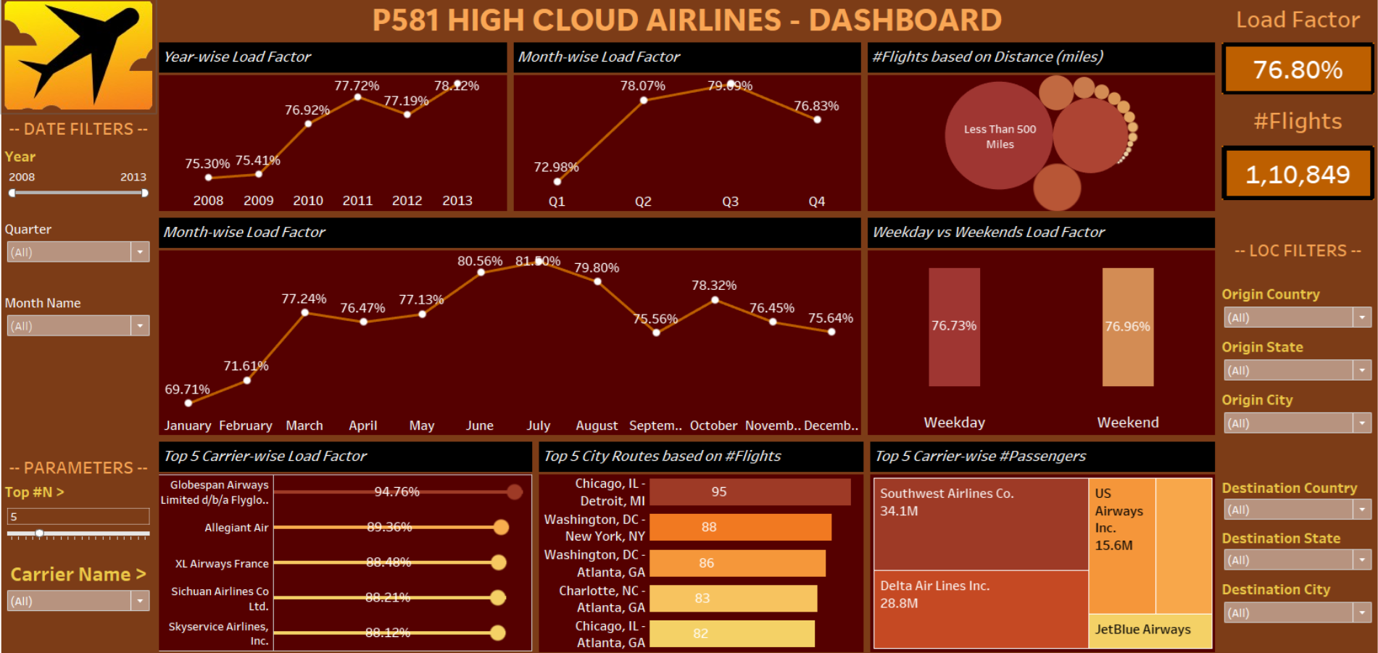
Tableau Dashboard

Slide 16
Conclusion
Key Takeaways:
Positive Industry Trends: The increasing YoY load factor highlights a strong overall performance for the industry.
Quarterly Load Factor Insights: Q2 and Q3 consistently show higher load factors, suggesting these periods are peak times. However, the low load factor in Q1 warrants further investigation to optimize performance.
Carrier Performance Discrepancy: The lack of overlap between top carriers by passenger count and load factor reveals potential inefficiencies in aircraft utilization.
Distance vs. Load Factor: The inverse relationship between flight distance and load factor suggests that shorter routes are underutilized. This finding can guide strategic adjustments in route planning and pricing.
Recommendations:
Operational Focus: Address Q1 low load factors through targeted promotions or schedule adjustments.
Carrier Optimization: Evaluate carrier efficiency to enhance aircraft utilization.
Strategic Adjustments: Reassess pricing and operational strategies for short-distance routes to improve load factors.

Slide 17

Thank You….

